Slide 1
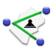

MyGIS.apk
By
Thabo Maqelepo
Boocha34

Slide 2
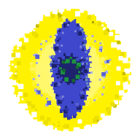




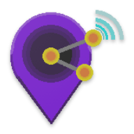



MyGIS Vx.x
What is it?
What Does it Do…
Application Layout
How does it do it…
What Can You Do With It…
Advantages…
Limitations…
POSSIBILITIES.

Slide 3






What is it
MyGIS is an Android application that can be used for a multitude of Geo-related activities and applications, and some of these may include but not limited to:
Creating, viewing and editing Geospatial data
Simplified Navigation (Moving Map)
Tracking of Geo located Objects
Sharing of Geospatial data between different devices and platforms

Slide 4
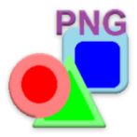
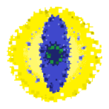




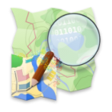
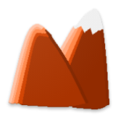

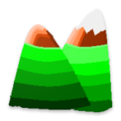
What Does it Do
MyGIS allows the user to view geo referenced maps which can be slaved to the device GPS, the maps are in plain PNG format that can either coupled with a “.pgw”projection file or a simple notepad defining the bounadry coordinates
Vector data can be displayed as a map overlay or viewed independently, using the native database format called EYEnid
MyGIS also supports Notepad and Spreadsheet CSV, DXF, KML(uncompressed) and JAVA Open Street Map (JOSM) data.
MyGIS also support XYZgrid data formats for basic 3D terrain modeling and relief analysis.

Slide 5





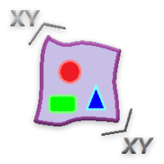

What Does it Do
Users can to create geographically accurate vector data either manually by touch or automatically by GPS.
Data can be created as either Points, Lines or Polygons.
Data can be created against a geo-referenced Platform (Map Overlay) or based on a Fake space.
Data can be created “In-Pocket”.

Slide 6





What Does it Do
MyGIS allows the user to manipulate vector data
Object vertices can be edited
datasets can be changed to different vector types (points-to-lines-to-polygons) and their color can be changed
Datasets can be converted to all formats supported by the App with the exceptions of Openstreet format.
All data within its working folders can be directly deleted form the App

Slide 7
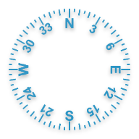

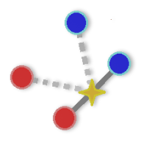
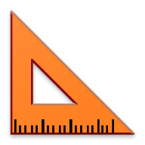
What Does it Do
MyGIS allows the User to Stakeout vector objects using a dynamic compass
MyGIS includes a measurement tool where an object’s Length, Perimeter and Area can be measured by free-hand or by snapping to the objects.
Vector Data can be shared to another MyGIS application directly via a Geo-Encoded or Geo-Packed Sms.
Maps and orther bulk data can be transferred via the ShareIt and Whatsap Platforms*

Slide 8
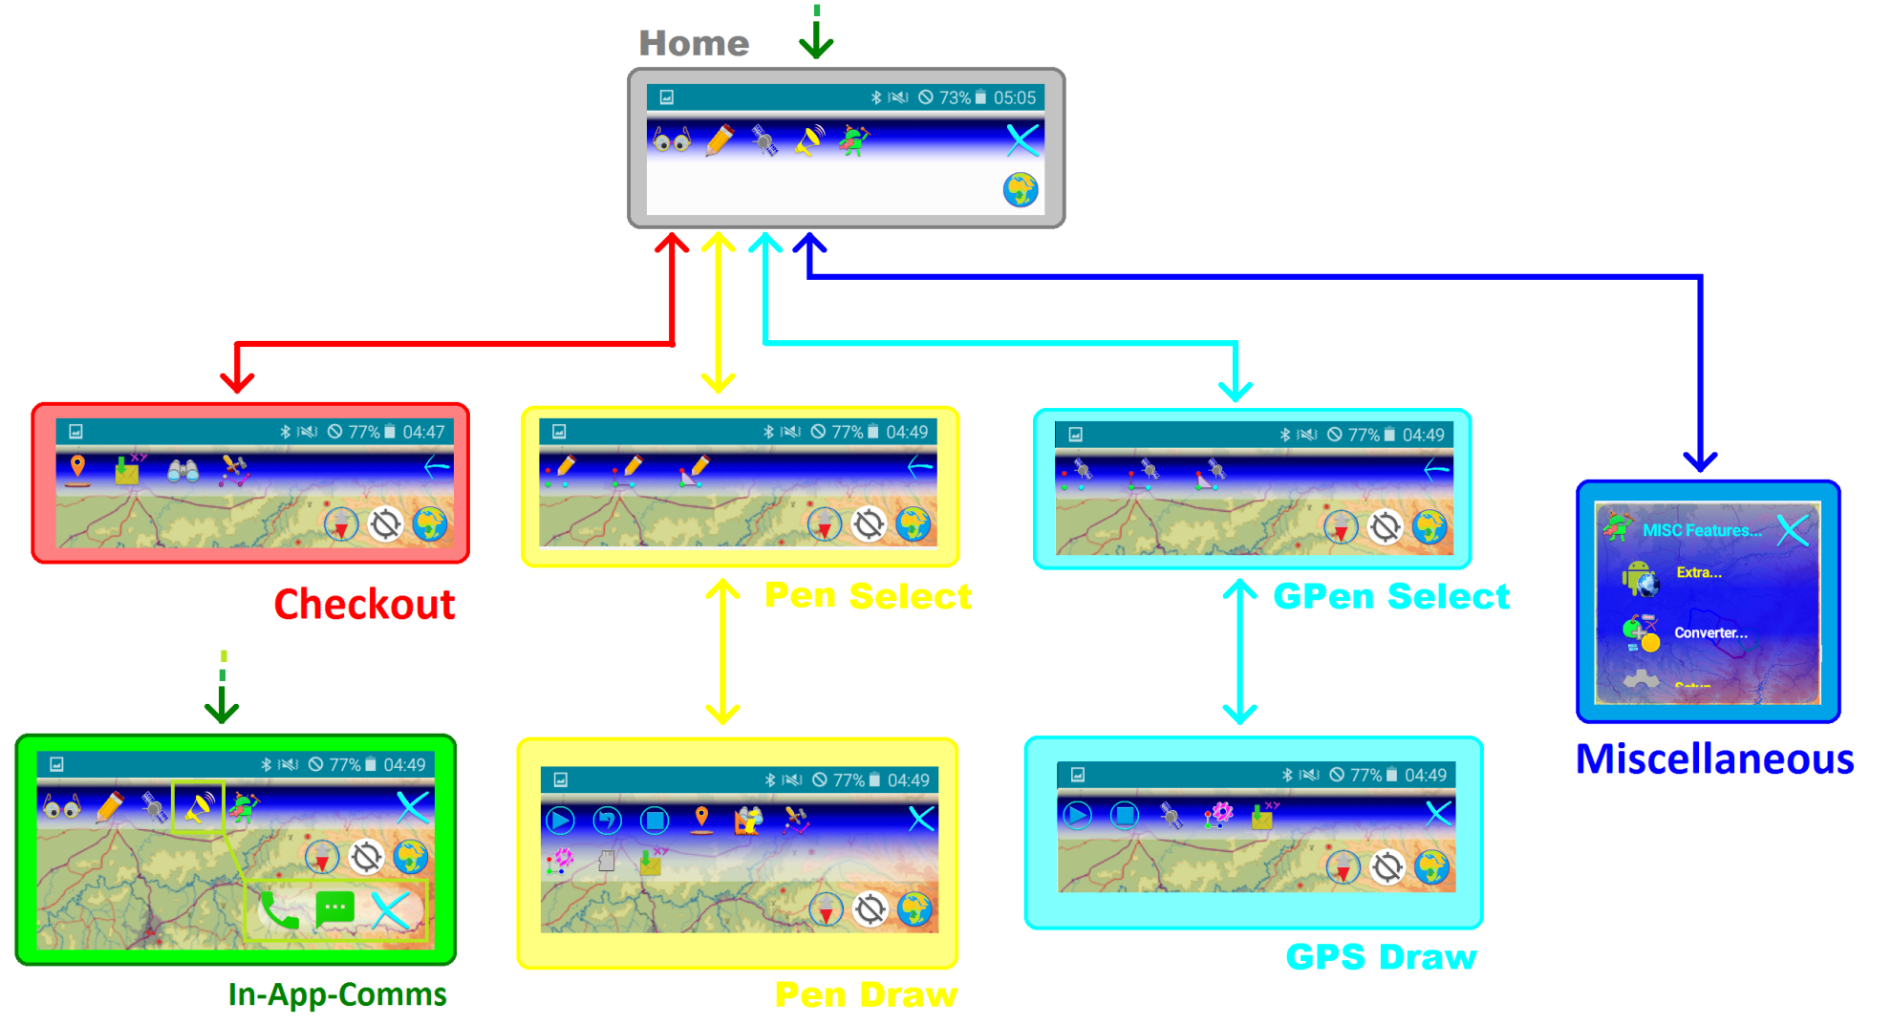
Application Layout

Slide 9
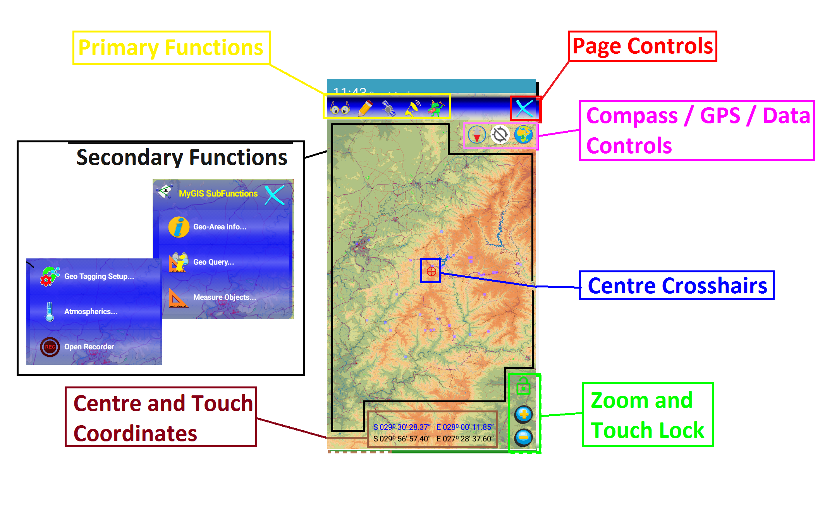
Application Layout

Slide 10
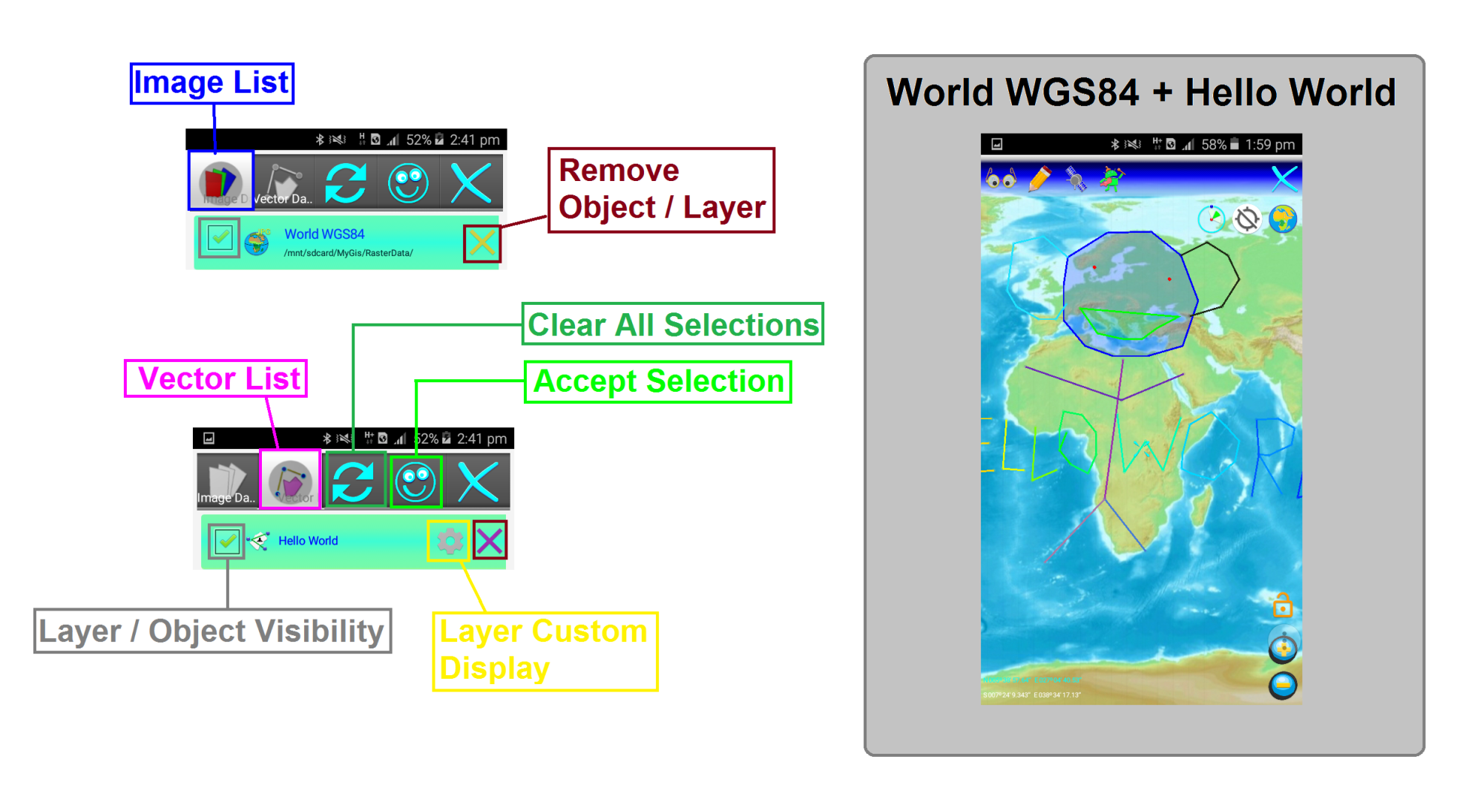
Application Layout
Data Access

Slide 11






Application Layout -Key Controls
Data Access
Map Crosshairs
GPS Control
Pen / Manual Draw Function
GPS / Auto Draw Function
Compass Control
Zoom Control*
“CLUELESS Function”

Slide 12
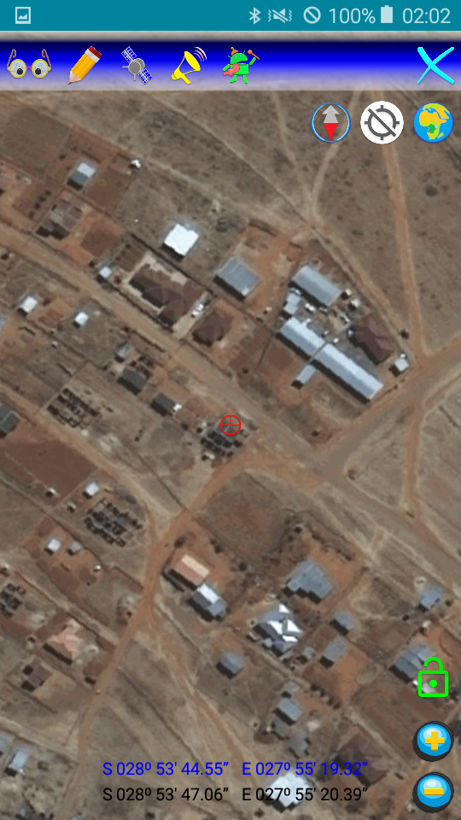
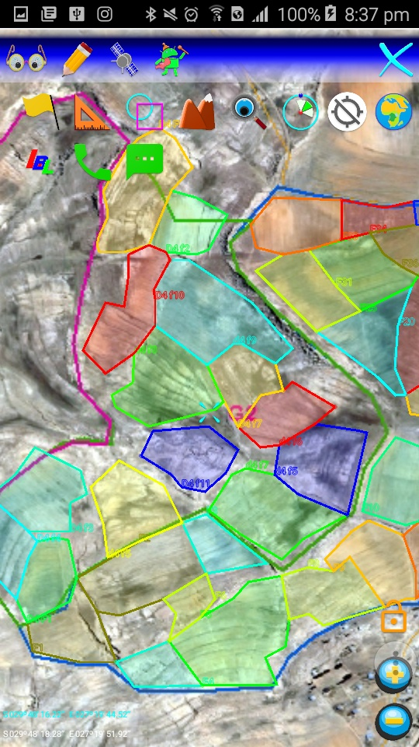
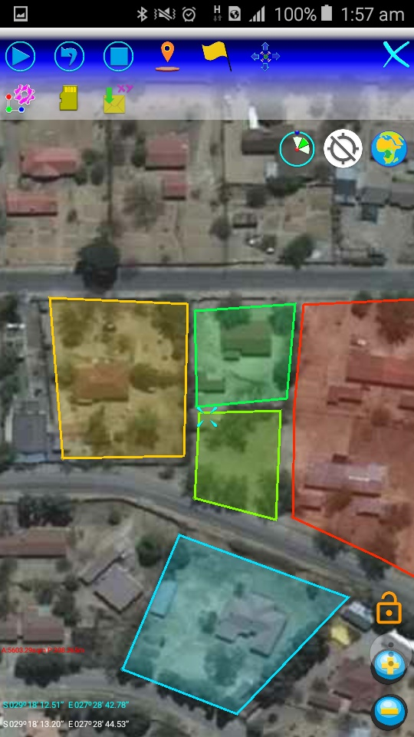
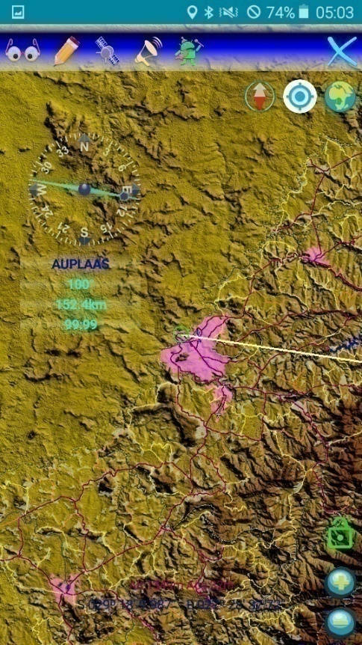
Application Layout -Screenshots Samples
Sketching the neighborhood
Searching for Trig
Pillar 9700074 /BT74
Agricultural land mapping

Slide 13
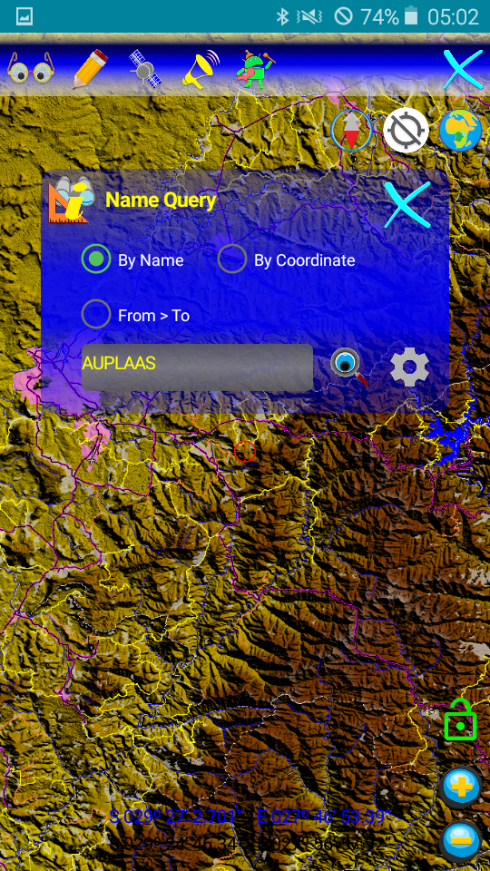
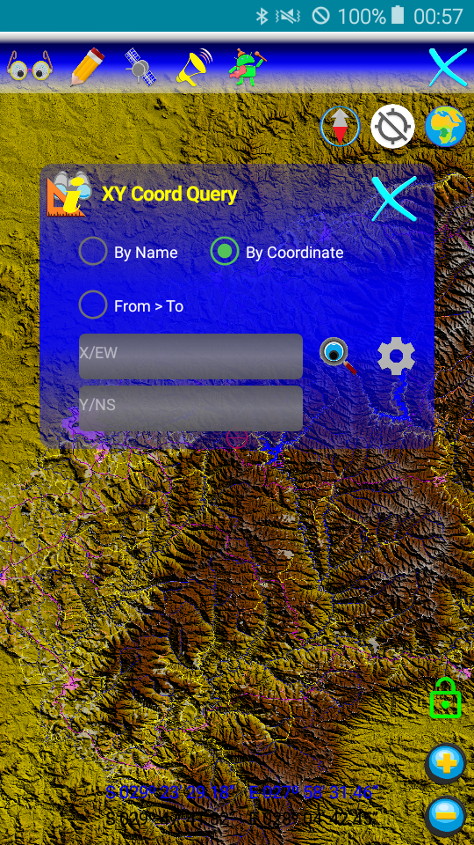
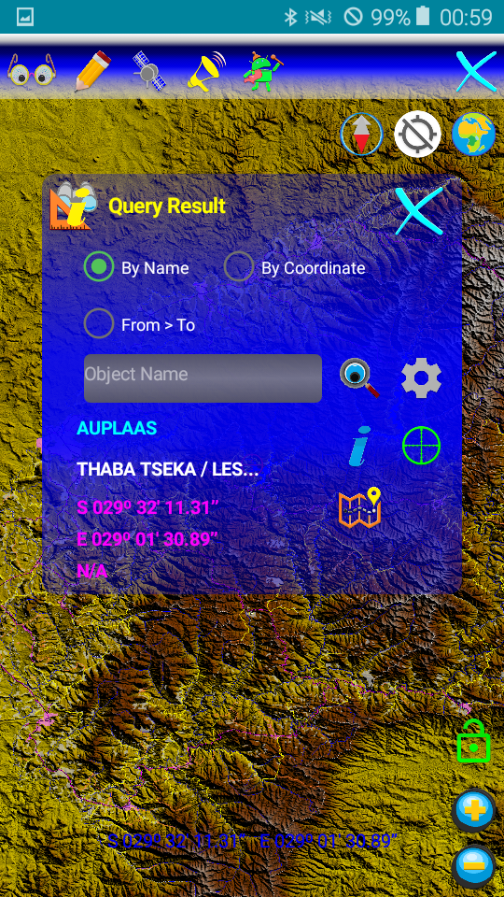
Application Layout -Screenshots Samples
Multiple ways of finding
Pre-stored and user created vector Objects
“One-touch” object property view

Slide 14
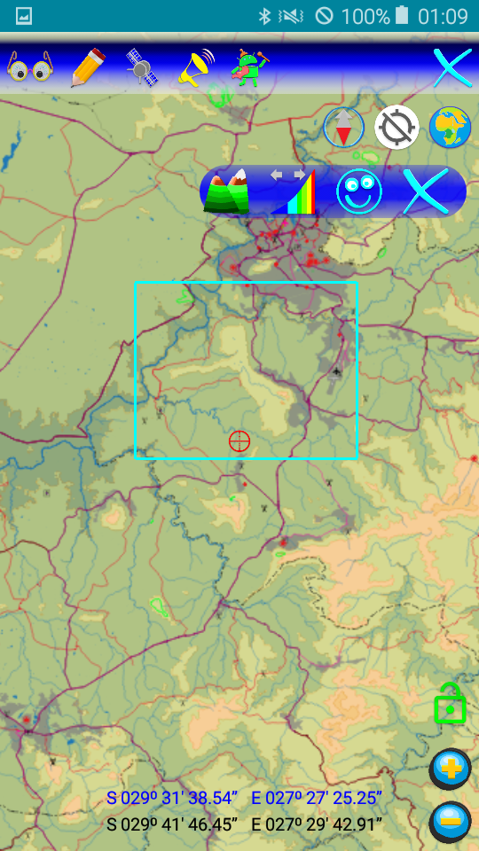
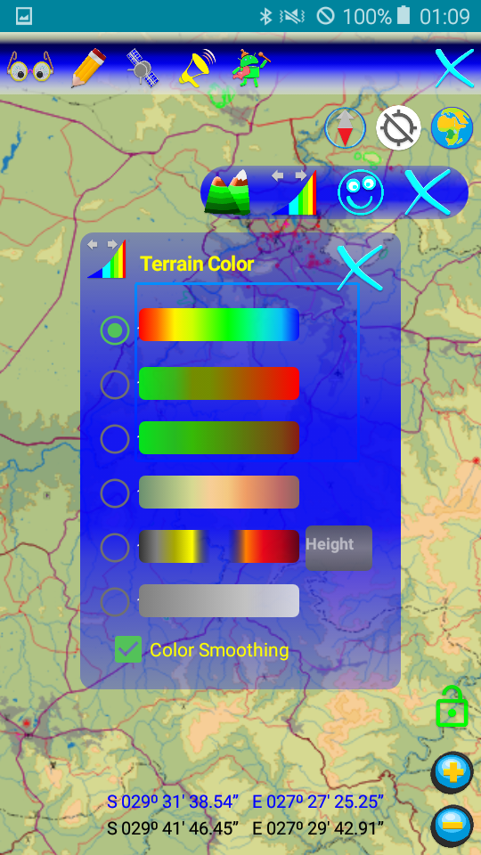
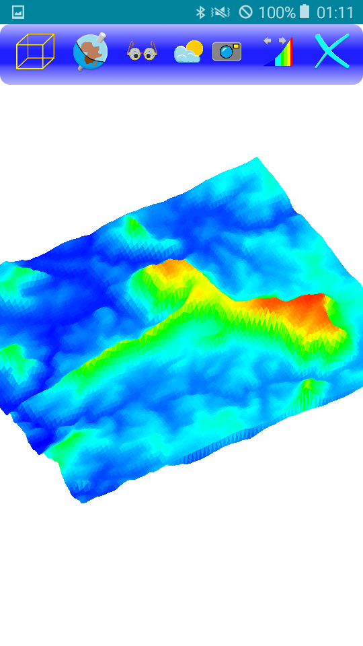
Application Layout -Screenshots Samples

Slide 15
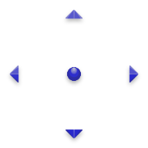
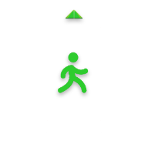
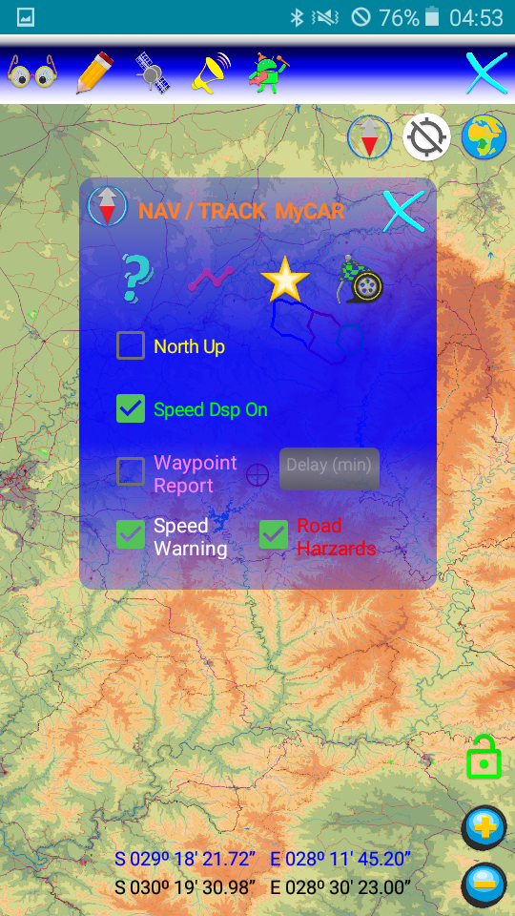
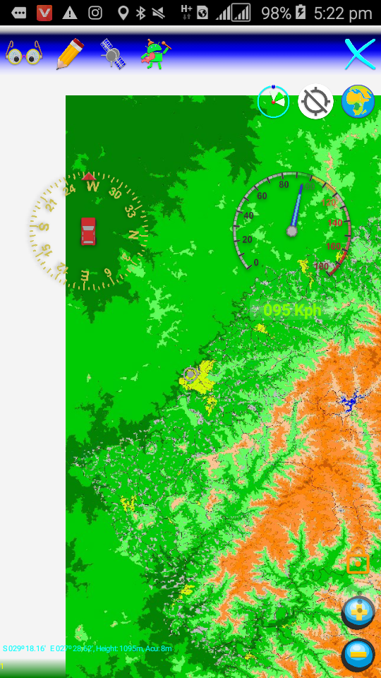
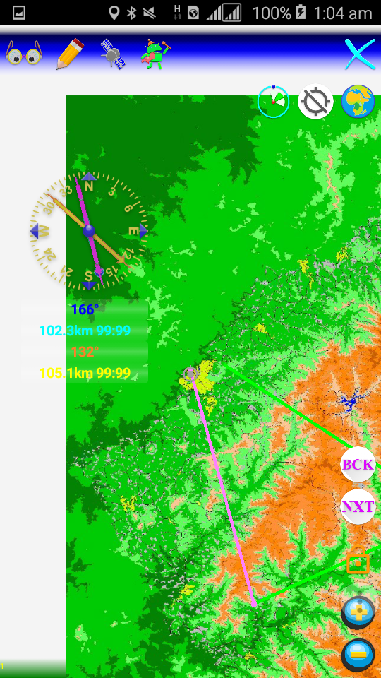
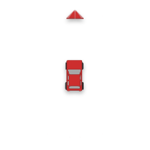
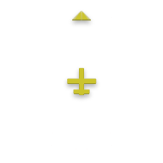



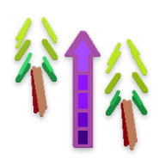
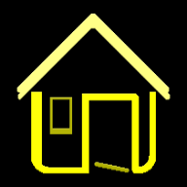
Application Layout -Screenshots Samples

Slide 16
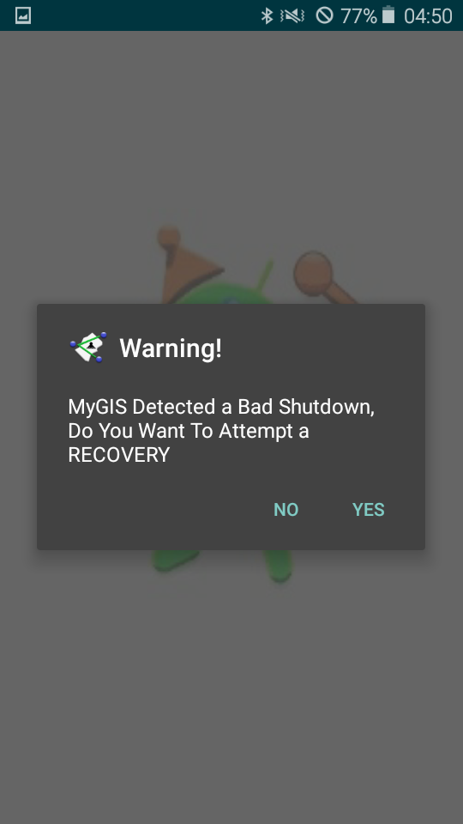
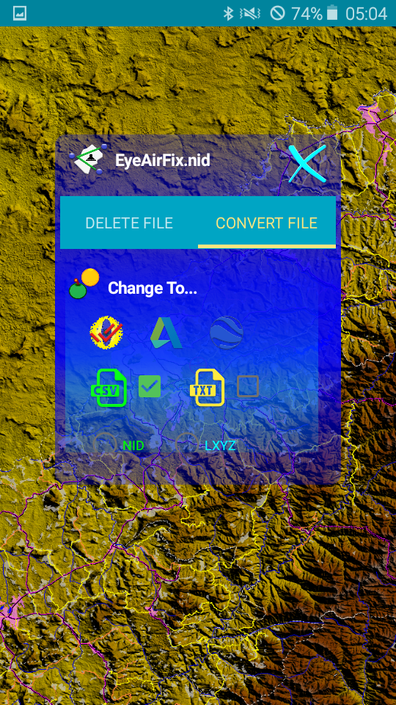
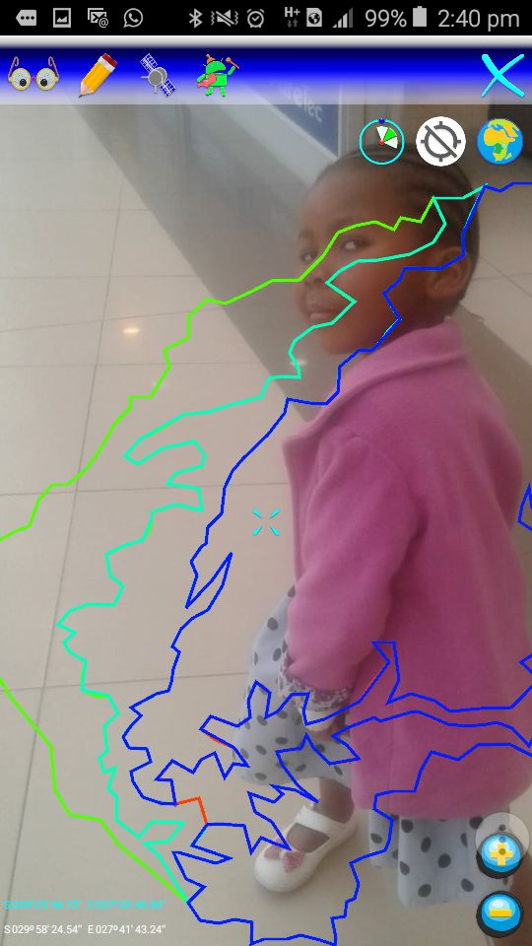
Application Layout -Screenshots Samples

Slide 17
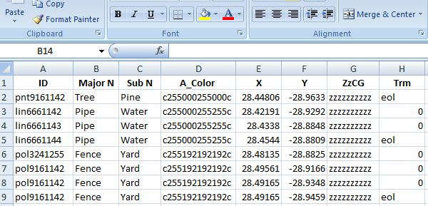
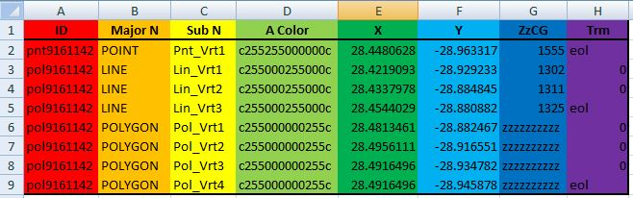
How does it do it
MyGIS uses a database format called EYEnid which to all application is a mere Comma Separated Plain CSV Ascii Text file.
The key to EYEnid’s applicability to a multitude of Geo-applications is in the “columns”.
ID
Major Name
Sub Name
Alpha-Color
X (Longitude)
Y(Latitude)
ZzCG Altitude / Data
Terminator

Slide 18
How does it do it
Vertex identifier (ID)
This is a vertex identifier that can either be unique to a single object such as a Point or represent a set of vertices as in the case of a Line or Polygon, examples of an identifier would be [pnt1000001] [lin2000002] [pol3000003].
the first letters of the identifier indicate whether a particular vertex is a Point(pnt) , Line(lin) or a Polygon(pol) and the following numbers are random generated.

Slide 19
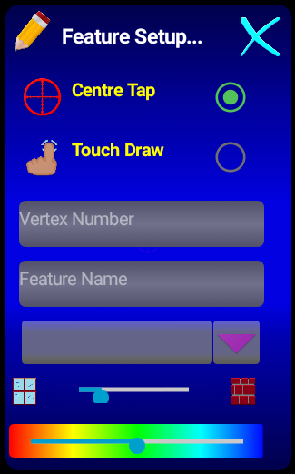
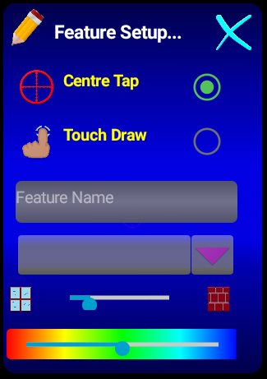
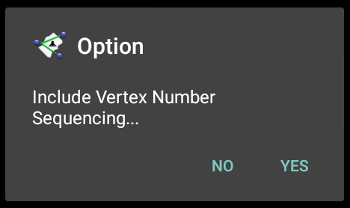
How does it do it
Major Name
This could be a generic name of an object or a number that will be treated as a sequence, example [Tree] [10001].
Minor Name
This could be a specific object name [Pine]
Note when drawing, MyGIS does not require
the user to give the objects a name as it
will auto generate the names.

Slide 20
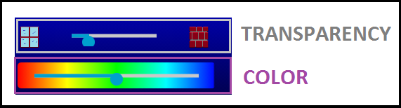

How does it do it
Alpha Color (Acol)
The color and transparency of an object
[ARGB] = [c255181230029c] = [c255 181 230 029c]
Alpha = 255 :000 is tranparent 255 is opaque
Red = 181
Green = 230
Blue = 029
The letters “c” are place holders to prevent 000 000 000 000
From being truncated to 0.

Slide 21
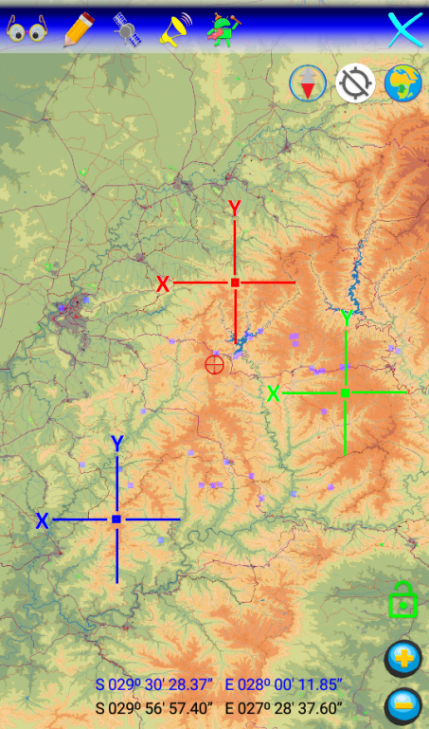
How does it do it
Longitude (X) Latitude (Y)
The Coordinates are in WGS84 projection and they can be in the form dd.ddddd, dd ° mm.mm ‘, dd ° mm ' ss.sss ".
29° 13' 35.3984" S , 28° 04' 20.3828" E
29° 13.58997' S , 28° 4.33971' E
29.22649956° S , 28.07232857° E

Slide 22
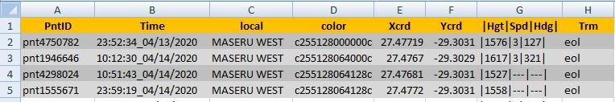
How does it do it
Special Height (ZzCG)
This column is multifunctional, could either represent height above mean sea level, relative height to a reference point or it can be to store any extra data that a particular Application function requires.

Slide 23
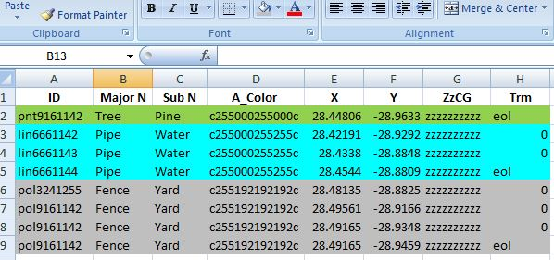
How does it do it
Object Terminator (Trm)
This is used to indicate the end of a vertex entry, this could either represent the termination of an object [eol end of line] or it could represent the end of a vertex in a series of vertices [o zero]
In the case of singe vertex objects such as “single entry points” they end with [eol], but for series entries they will end with [0] until the last vertex which will be capped with [eol].

Slide 24




What can YOU do with MyGIS
EVERTHING
MyGIS is primarily a GIS app
Can be used for Viewing, Logging and Editing Geo-Data.
Data can be captured in a multitude of ways Touch-Tap, Centering, GPS-Spot, Library Local, Geo-Sms.

Slide 25
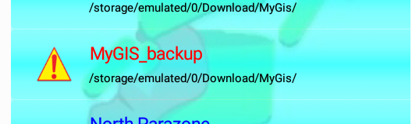
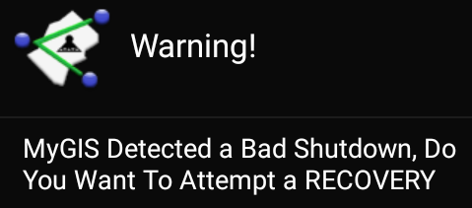
What can YOU do with MyGIS
Dynamic and hard data backup during capturing.
THERE IS ALWAYS A BACKUP.

Slide 26

What can YOU do with MyGIS
Dataformats can be interchanged to ease export to other mapping platforms.
MyGIS allows for basic data statistics calculation.
Geo data can be exchange via conventional Short Message Service (SMS) or as an Email with attachments
And many many more…

Slide 27

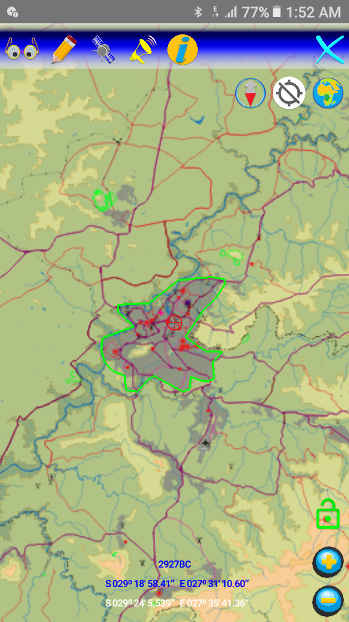
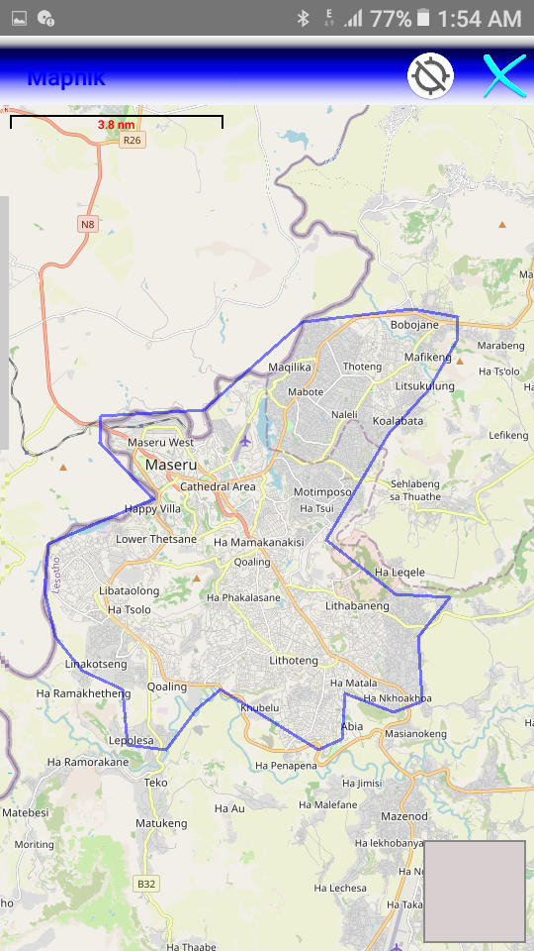



What can YOU do with MyGIS
MyGIS allows data to be overlaid on the OpenStreet® Web view with the help of the OSMdroid feature on B4A Android™.

Slide 28





What can YOU do with MyGIS
MyGIS can generate an A4 PDF of the displayed map along with details of the vector data such as coordinates and dimensions.

Slide 29




What can YOU do with MyGIS
MyGIS has a crude atmospherics calculator and visualizer whereby the user can insert the current weather conditions such as temperature, pressure, etc to get density, dew point and icing altitude amongst other things

Slide 30









What can YOU do with MyGIS
And many many many more…

Slide 31
Advantages of MyGIS
Tiny Size for its capabilities 21Mb

